Slide 1


Assignment 2
Student Managing Record

Slide 2
Presented By
Iqra Yaqoob(44566)
Mariam Sohail(45773)
Samiyya Aftab(46891)
Aiman Shafique(44560)
Afrah Abdulrub()

Slide 3
REAL-WORLD PROBLEM:
Duplicate records happen
wrong counting
Searching slow
Data is not organized

Slide 4
DEFINE
SETS

Slide 5
What is Sets ?
Sets are collections of distinct elements.
In software systems, sets help group related data for quick and efficient processing.

Slide 6
Key Characteristics of a Set:
Elements are unique (no repetition).
The order of elements doesn’t matter.
Sets are written using curly braces {}.
Example :
Student = { Sara,Iqra,Sadia,Rimsha}

Slide 7
Types of Set Representation
Statement Form
Roster (tabular form)
Set builder Form

Slide 8
Statement Form
Set is described using a simple sentence.
Example: "A is the set of all vowels in the English alphabet."

Slide 9
Roster (Tabular) Form
All elements of the set are listed explicitly in curly brackets.
Example: A = {a, e, i, o, u}

Slide 10
Set-builder Form
Describes elements using a rule or property.
Example: A = {x | x is a vowel in English}

Slide 11
Why Use Sets in Student Management?
Easy classification and grouping of students.
Simplifies filtering, searching, and reporting.
Useful for decision-making, eligibility checks, and performance tracking.

Slide 12
Identification of Sets in senario
Students Enrolled in SE2022
Students Who Passed the Midterm
student who fail the midterm
Students With ≥75% Attendance.... etc.

Slide 13
EXAMPLES OF SETS RELATED TO MANAGING STUDENT RECORDS

Slide 14
Identification of Sets in senario
Set U: {student | students who enroll in the university batch of SE2022}
Example: SET U={Sara, Fatima, Ahmed, Omar , Sadia, Iqra , Sabeen, Ayesha, Zain, Shaziya }
Set B: {student | student that pass in midterm exam }
Example: Set B = {Sadia, iqra, Omar, shaziya}

Slide 15
Identification of Sets in senario
Set C: {Student | student that submit their assignment in time }
Example: Set C = {Ali, Sara, sabeen, Ayesha}
Set D: {student | student who apply for scholarship }
Example: Set D = {Ahmed, Zain, iqra}

Slide 16
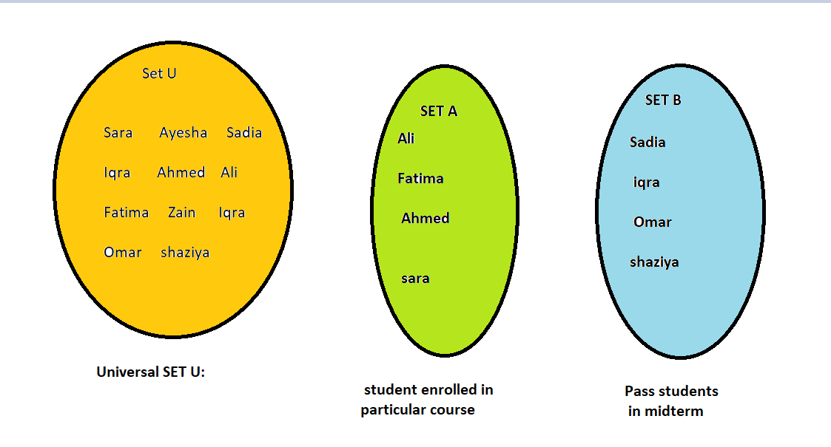
Visual Representation of Sets
(Venn Diagram)

Slide 17
SET OPERATION

Slide 18
What is set operation?
The set operations are performed on two or more sets to obtain a combination of elements as per the operation performed on them.

Slide 19
Types of set operation:
There are five basic types:
Union (A ∪ B)
Intersection (A ∩ B)
Difference (A - B or B - A)
Symmetric Difference (A △ B)
Complement (Aʹ or U - A)

Slide 20
1. Union (A ∪ B)
Definition:
The union of two sets A and B is the set of all elements that are in A, in B, or in both.
Symbol: ∪
Formula: A ∪ B

Slide 21
Properties:
A ∪ B = B ∪ A (Commutative)
(A ∪ B) ∪ C = A ∪ (B ∪ C) (Associative)
A ∪ ∅ = A (Identity)
A ∪ A = A (Idempotent)

Slide 22
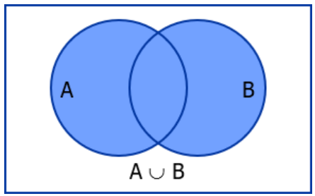
1. Visual Representation of Union

Slide 23
1. Union (A ∪ B)
Example:
Let:
A = {Ali, Sara, John}
B = {John, Meena, Ahmed}
Then:
A ∪ B = {Ali, Sara, John, Meena, Ahmed}
Explanation:
"John" is in both sets, but appears only once.
The union brings all unique students from both sets.
Use in Real Life:
Useful when combining student lists from two classes or programs.

Slide 24
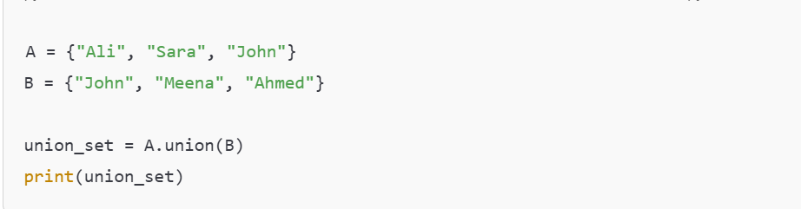
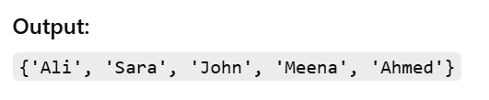
1. Union (A ∪ B)

Slide 25
2. Intersection (A∩B)
Definition:
The intersection of sets A and B is the set of elements that are common to both A and B.
Symbol: ∩
Formula: A ∩ B

Slide 26
Properties:
A ∩ B = B ∩ A (Commutative)
(A ∩ B) ∩ C = A ∩ (B ∩ C) (Associative)
A ∩ ∅ = ∅ (Identity)
A ∩ A = A (Idempotent)

Slide 27
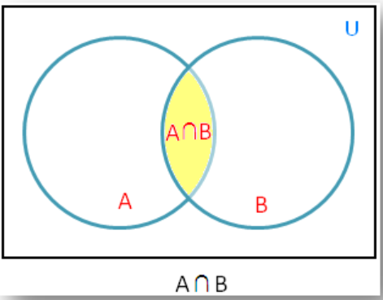
2. Visual Representation of Intersection

Slide 28
2. Intersection (A∩B)
Example:
Let:
A = {Ali, Sara, John}
B = {John, Meena, Ahmed}
Then:
A ∩ B = {John}
Explanation:
Only "John" is present in both sets.
Use in Real Life:
Useful to find students who are enrolled in both subjects or programs.

Slide 29
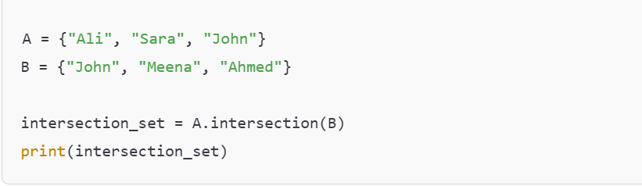
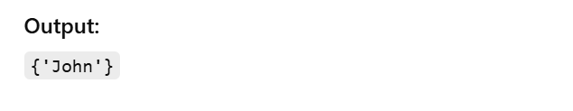
2. Intersection (A∩B)

Slide 30
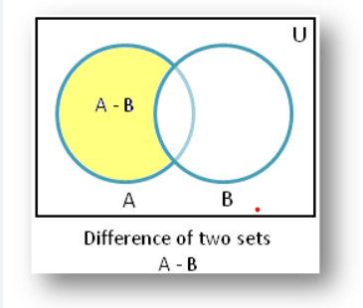
3. Difference (A-B)
Definition:
The difference of sets A and B is the set of elements that are in A but not in B
Symbol: −
Formula: A − B

Slide 31
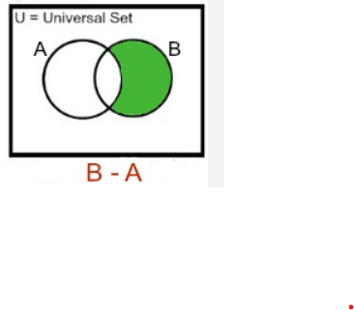
3.1 Reverse Difference (B-A)
Definition:
The reverse difference of sets B and A is a set containing elements that are in B but not in A
Symbol: −
Formula: B − A

Slide 32
Properties:
A − B ≠ B − A(Not Commutative)
(A − B) − C ≠ A − (B − C)( Not Associative)
A − ∅ = A(Identity)
A − A = ∅ (Domination)

Slide 33
Difference (A-B)
Example:
Let:
A = {Ali, Sara, John}
B = {John, Meena, Ahmed}
Then:
A − B = {Ali, Sara}
Explanation:
Only "Ali" and "Sara" are in Set A but not in Set B.
Use in Real Life:
Useful to find students who left a course or are only enrolled in one specific subject.

Slide 34
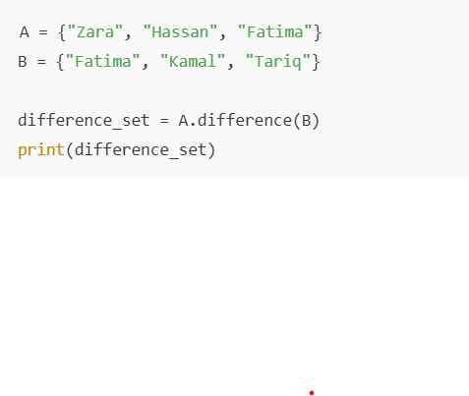

3. Difference (A-B)
Output:

Slide 35
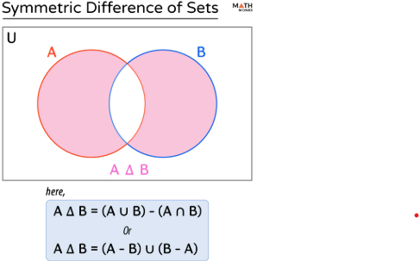
3.2 Symmetric Difference
Definition:
The symmetric difference of two sets A and B is the set of elements that are in either A or B, but not in both
Symbol: △ or ⊕
Formula: A △ B = (A − B) ∪ (B − A)

Slide 36
3.2 Symmetric Difference
Example:
A = {Areeba, Bilal, Daniyal, Hina, Saad}
B = {Hina, Saad, Komal, Farhan, Zayan}
A △ B = {Areeba, Bilal, Daniyal, Komal, Farhan, Zayan}
Explanation:
Only "Hina" and "Saad" are common in both, so they are excluded.
Remaining elements from A and B form the symmetric difference.

Slide 37
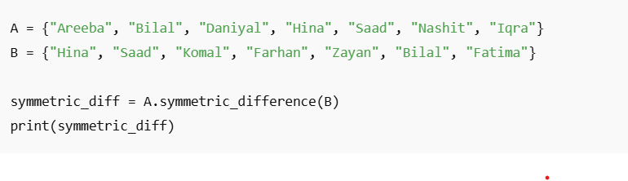
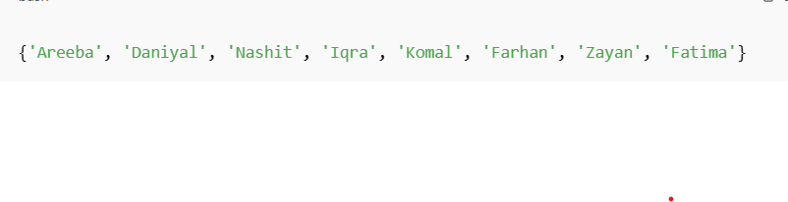
Symmetric Difference (A △ B)
Output:

Slide 38
IMPLEMENTATION

Slide 39
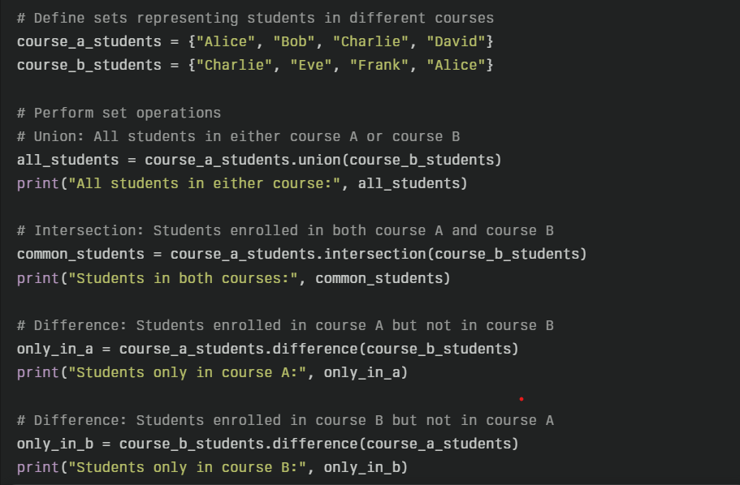
Python🐍💻

Slide 40
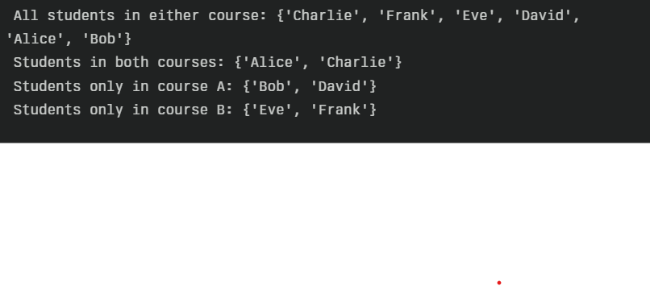
Python🐍💻
OUTPUT:

Slide 41
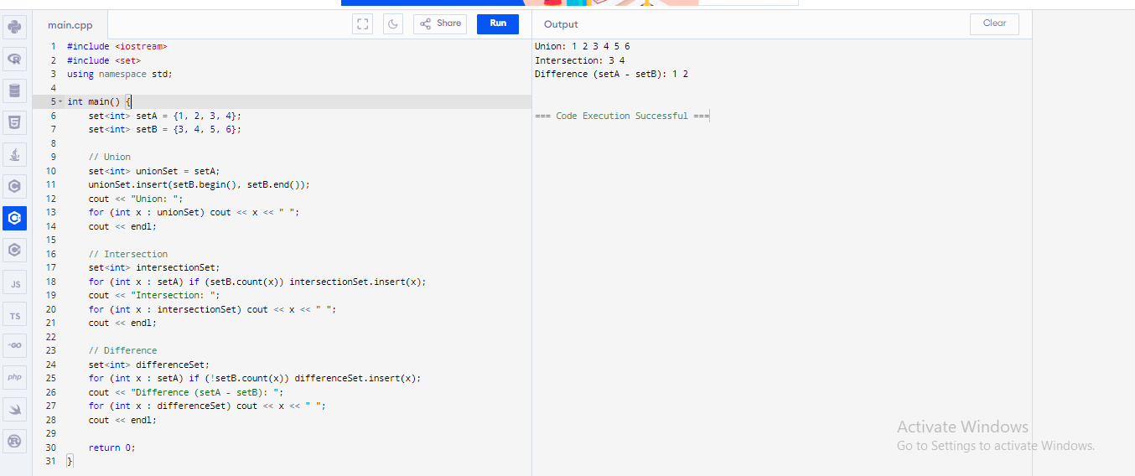
c++

Slide 42
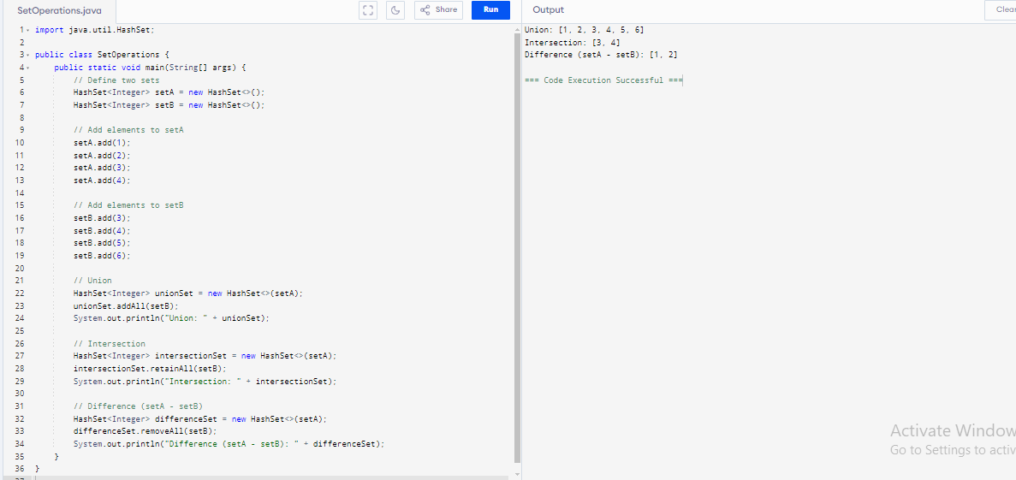
JAVA

Slide 43
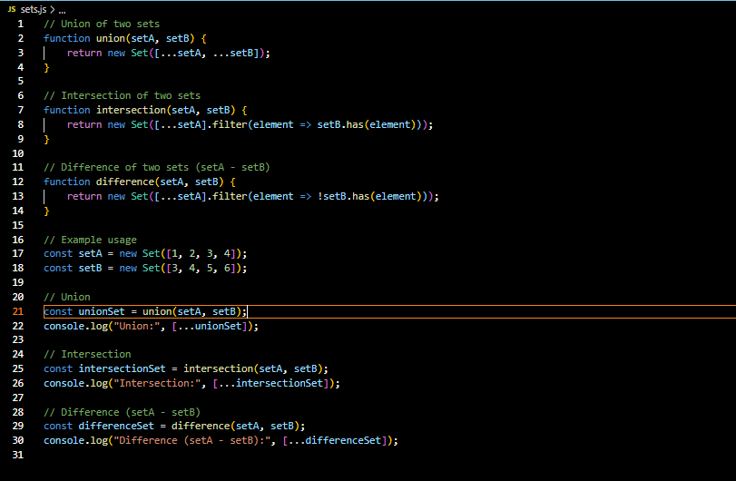
JAVA SCRIPT

Slide 44
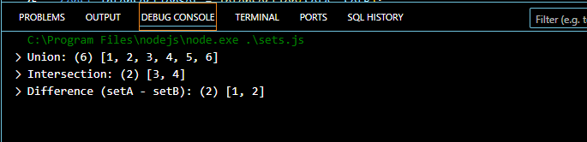
OUTPUT:

Slide 45
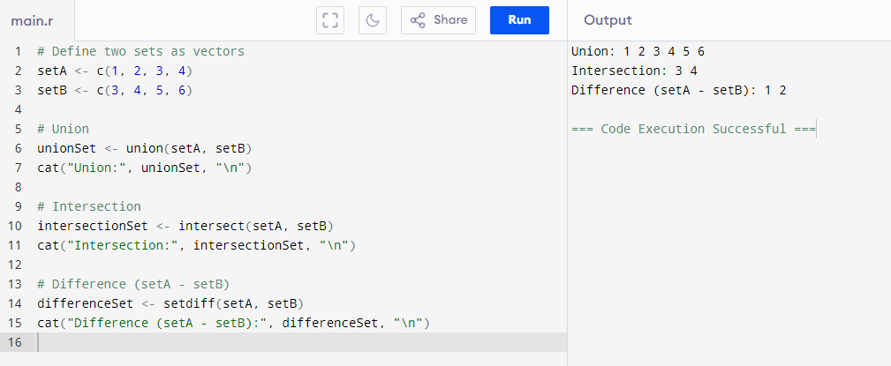
R language

Slide 46
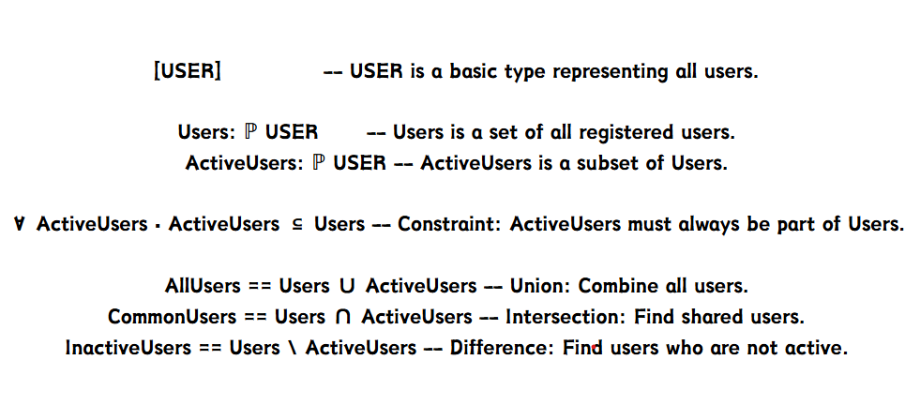
Z Notation

Slide 47
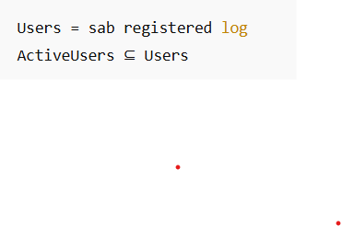
SET THEORY IN FM
Helps Build Software: Set theory is useful for making software.
Manages Data: It helps organize and handle data well (like in databases).
Clear Rules: It makes rules for software very clear and exact.
Example:

Slide 48
Real Benefits
Better Code: make code simpler and faster.
Fewer Mistakes:set theory helps reduce errors.
Reliable Systems: Helps make sure systems work well.
Where It's Used: Used in security, databases, and AI.

Slide 49


Slide 50
THANK YOU

